Slide 1
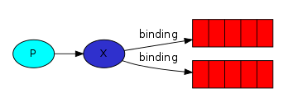

RabbitMQ Messaging Model
A producer is a user application that sends messages.
The core idea in the messaging model in RabbitMQ is that the producer never sends any messages directly to a queue. Actually, quite often the producer doesn't even know if a message will be delivered to any queue at all.
Instead, the producer can only send messages to an exchange. An exchange is a very simple thing. On one side it receives messages from producers and the other side it pushes them to queues. The exchange must know exactly what to do with a message it receives. Should it be appended to a particular queue? Should it be appended to many queues? Or should it get discarded. The rules for that are defined by the exchange type.
There are a few exchange types available: direct, topic, headers and fanout.
A consumer is a user application that receives messages.
A queue is a buffer that stores messages.

Slide 2
RabbitMQ Messaging Model

